Slide 1

Component Life Agile Team Overview Presentation
Notes:
Cassandra/Manny

Slide 2
Introduction
Maintenance
Intervention
Recommendations
Sustainability
Future Opportunities
Notes:
Cassandra/Manny

Slide 3
Component Life Team Members
Executive Sponsor: Cory Stevens
Stakeholders: Leeland Boday, Toby Dunn, Steve Pangburn, Mona Ogas, Tim Webb, Karl Reid, Dennis Sorensen
Scrum Team
Product Owner
Manny Herrera
Scrum Master
Cassandra Galvez
OI- David Barnes
OI- Luis Ochoa
Data Science- Mike Bischof
Oil Lab- Colin Cunningham
MOR- Willey Biggs
SIE- Antonio Corral
SIE- Chet Shiflet
BAG-Ted Puleston
CHI- Wayne Toney
TYR- Royce Parra
SAF- Brady Norton
CMX- Shawn Clarno
CMX- Jason Anderson
CV- Diego Malaga
CV- Carlos Arrayan
ElA- Anibaldo Aracena
ElA- Guillermo Vilches
Empire- Trent Reidhead
Empire- Jared Townley
Empire- Jamie Moore
Ferreyros- Jorge Tokashiki
Wagner- Russell Flamm
Wagner- Tim Eldred
Finning- Mario Ananias
Finning- Jorge Selti
CAT- Josh Wirsching
SMEs
FMI: Craig Willis, Luis Montoya, Frank Aguirre, Mitch McInally, Buddy Aguinga
Empire: Tyler Dixon
Notes:
Manny Slide 1-7

Slide 4
Caterpillar Component Life Burning Platform and Vision
Caterpillar Component life has historically been measured simply utilizing service hours. While this traditional measurement has taken Component life to where it currently is, there has been a pivot toward measuring component life by work. Recently, the same strategy was applied to engines and the results have been promising. Component life can be measured using the same data driven approach. Some examples could be, utilizing travel hours, number of shifts versus service hours will deliver the expected improvement.
Component removal and installation is a high-risk task as identified by the fatal risk management (FRM) guidelines. There are seven fatal risks that apply to Component R&I. High risk exposure reduction is estimated to be ~1,900 man-hours per year by measuring final drive removal intervals using travel hours as the measure of life as one example.
FCX spends a substantial dollar amount on 793 5 major Components equating to ~$100 MM on 2019 for only components cost. Furthermore, average Component utilization differs between model and site due to different operational and maintenance practices between the sites.
Employing a data driven approach to quantify Component life reduces technician exposure and increased safety is the net result. With this knowledge, there is a need to create standardized maintenance best practices and intervention strategies to drive the number of failures down as well as maximize Component life. By implementing this data driven process and optimizing life component it is estimated a potential saving of ~$9.2 MM based on 2020 data.
In summary, this project aligns with FCX’s overarching 2020 Vision: Focusing on Immediate Value. Utilizing data to make removal decisions rather than traditional methods has been proven to maximize component life. Can we count on your support?
Notes:
Manny Slides 1-7
Overall final drives are utilized 53% for B model trucks, 59% for C model trucks, and 62% for D model trucks. These numbers are based upon 828 final drive removals for the years 2017-2020. When measuring final drive life by travel hours, only 25 finals reached the proposed targets of 13K travel hours for B and C model trucks and 15K travel hours for D model trucks. Based on 2019 PCR data, we can calculate cost savings associated with maximizing our component life; ~$8.6MM per year based on reducing the number of final drive removals required.
Root cause failure analysis has indicated that catastrophic failures account for 43.3% of total final removals. The most common failure mode for final drives is contact stress fatigue. Contamination is normally the root cause identified for contact stress fatigue.

Slide 5
Team Objective and Key Results
Objective 1: Reduce High Risk Exposure to our employees by extending component life.
Reduce planned man hours required by December 31, 2020.
Objective 2: Develop metrics to maximize component life at the lowest cost.
Define indicator and target value for Transmission life by November 30, 2020.
Objective 3: Standardize component rebuilds performed by dealers.
Establish best practices that will aid our current technicians by December 31, 2020.
Establish best practices in training future technicians by January 31, 2021.
Define indicator and target value for Torque Converter by November 30, 2020.
Define indicator and target value for Final Drives/Differentials by November 30, 2020.
Review and refine reusability guidelines and customer guidelines for rebuilds by November 30, 2020.
Define life of hard parts by November 30, 2020.
Key Results
Key Results
Key Results
Notes:
Manny

Slide 6
Define Metrics, Targets
Metrics for different components:
Differentials – 15,000 Travel Hours
Final Drives – 15,000 Travel Hours
Transmissions – 15,000 Travel Hours
Torque Converters – 1,000,000 gallons of Fuel Burn
Differentials/Final Drives/Transmissions:
Travel Hours: Sum of time where the haul truck’s payload status is 'Travel Loaded’ or 'Traveling Empty' (data source: PI)
Torque Converters:
Fuel Consumption: Based on the “Engine Fuel Rate”-tag and in 1-second intervals, fuel consumption is aggregated to daily fuel consumption (data source: PI)
Notes:
Manny

Slide 7

How is Success Measured?
Success is measured by total travel time achieved rather than failure rate. In other words, as long as the component achieved at least 15K travel hrs. or 1MM gallons for TC, while the component cost remains steady, we are succeeding.
Notes:
Manny

Slide 8
Utilizing of Our System of Record is not an Option
Notes:
Willey B. 8-9

Slide 9
How do We Build Trust in the System of Record (SAP)?
Re-communicate the SAP component tracing process to all sites. Clearly define the process, goals, expectations, benefits, etc.
The rollout process should be customized for each site while utilizing the feedback collected.
Focus on Leadership support, training, and sites bandwidth.
All Sites
Identify a site champion that will lead and be responsible to make the transition from tracking components in Excel spreadsheets to fully utilizing our system of record (SAP)
Identify a sponsor who will have the overall accountability for this project
EGST to provide ongoing support to sites
Sites are in constant flux thus making ongoing support essential to sustaining this process
Notes:
Willey B.

Slide 10
Forecast and Year over Year Comparisons
Notes:
Dave B. 10-14

Slide 11
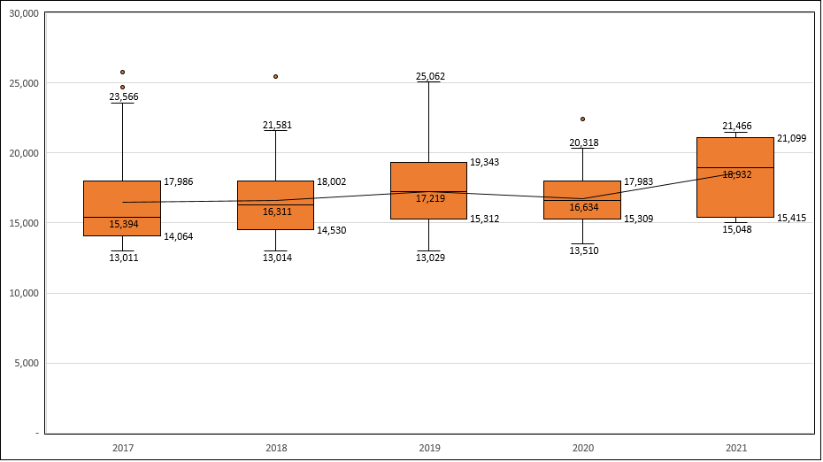
Differential PCR Hours, by Year – All Sites
*Data from Master Component Sheet with the addition of 2021 data from Site spreadsheets, component coded PCR, filtered for >13,000 service hours
Notes:
Dave

Slide 12
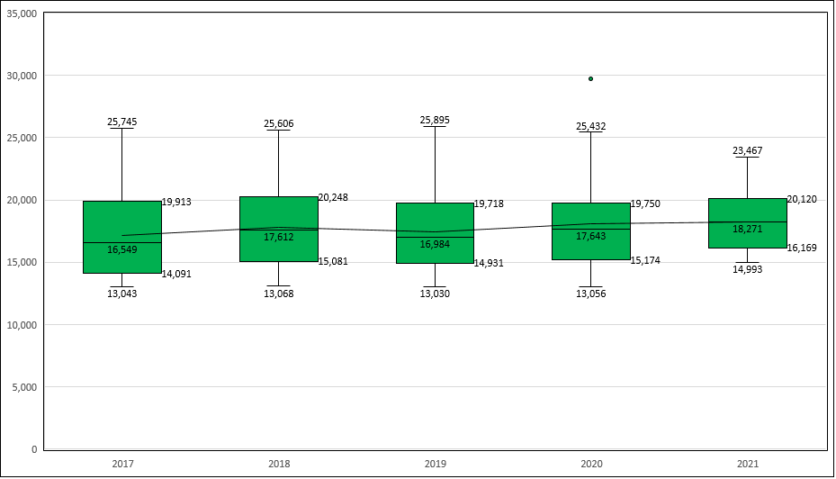
Final Drive PCR Hours, By Year – All Sites
*Data from Master Component Sheet with the addition of 2021 data from Site spreadsheets, component coded PCR, filtered for >13,000 service hours
Notes:
Dave

Slide 13
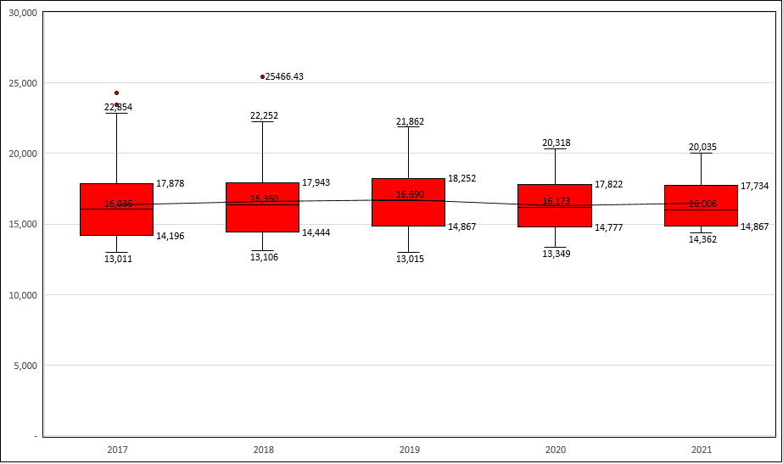
Transmission PCR Hours, by Year – All Sites
*Data from Master Component Sheet with the addition of 2021 data from Site spreadsheets, component coded PCR, filtered for >13,000 service hours
Notes:
Dave

Slide 14
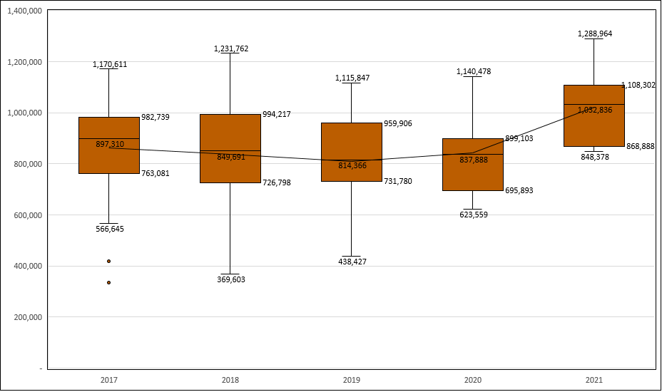
Torque Converter Fuel Consumption, by Year – All Sites
* Data from Master Component Sheet with the addition of 2021 data from Site spreadsheets, component coded PCR, filtered for >350,000 gallons of fuel consumption
Notes:
Dave

Slide 15
Cost per Hour Comparisons
Notes:
Dave/Manny 15-19

Slide 16
Cost per Hour Comparison – Differential

Slide 17
Cost per Hour Comparison – Final Drive

Slide 18
Cost per Hour Comparison – Transmission

Slide 19
Cost per Hour Comparison – Torque Converter

Slide 20
Estimated Cost Savings per Year
Notes:
Dave B. 20-25

Slide 21
Cost Analysis Detailed Methodology
Calculating Diff/Final/Trans PCR $/Year:
$$Site\frac{\$}{yr}=2020 Site Oper. Hrs∗\frac{2020 Site PCR Interval∗Diff, Final, or Trans Cost}{24000 hours}$$
Calculating Torque Converter PCR $/Year:
$$Site\frac{\$}{yr}=2020 Site Oper. Hrs∗\frac{2020 Site GPH∗Torque Converter Cost}{1 MM Gal}$$
Assumptions:
Site operating hours = Ready Production hrs + Operational Delay hrs + Shift Change hrs for 2020 (goal is time the truck is running)
Current PCR interval taken from Oct. 2020 FCST
Component cost is estimated at Jan. 2020 average* dealer prices
Gallons/hour for T/C calculation estimated from 2020 MEM fuel burn data
1 MM Gal PCR interval for T/C calculated from 2020 site gal/hr
*SA average after FESA CAP+MER discount is applied
Notes:
Dave B.

Slide 22
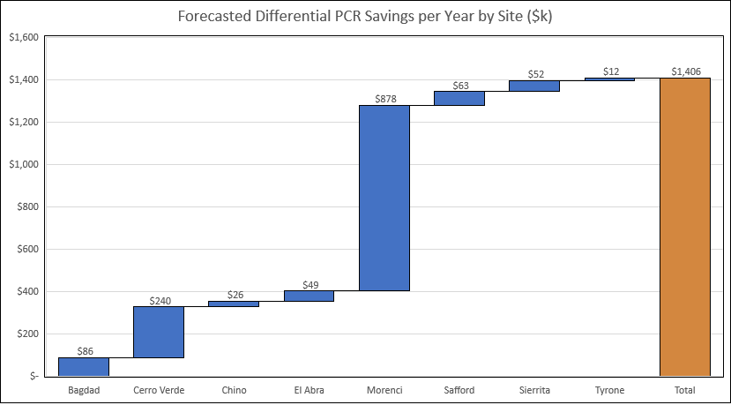
Forecasted Differential PCR Savings per Year
PCR quantity is based off average number of PCRs needed per year using 2020 operating hours; actual numbers each year may be higher/lower than average
Total estimated FMA cost savings of $1.4MM/year
*Estimate based on Jan. 2021 average component costs, 2020 operating hours, and Oct. 2020 PCR intervals
Notes:
Dave B.

Slide 23
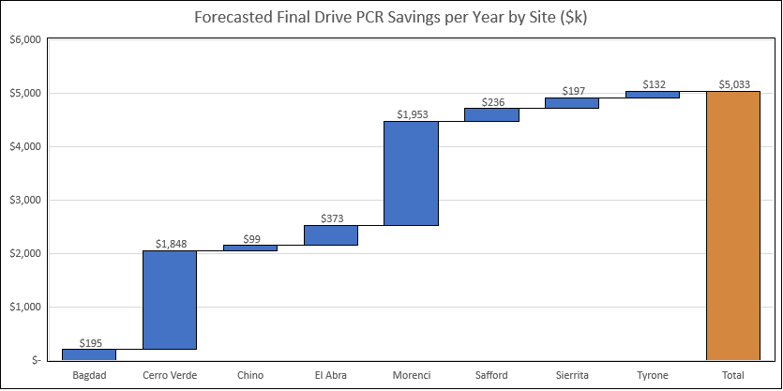
Forecasted Final Drive PCR Savings per Year
PCR quantity is based off average number of PCRs needed per year using 2020 operating hours; actual numbers each year may be higher/lower than average
Total estimated FMA cost savings of $5.03MM/year
*Estimate based on Jan. 2021 average component costs, 2020 operating hours, and Oct. 2020 PCR intervals
Notes:
Dave B.

Slide 24
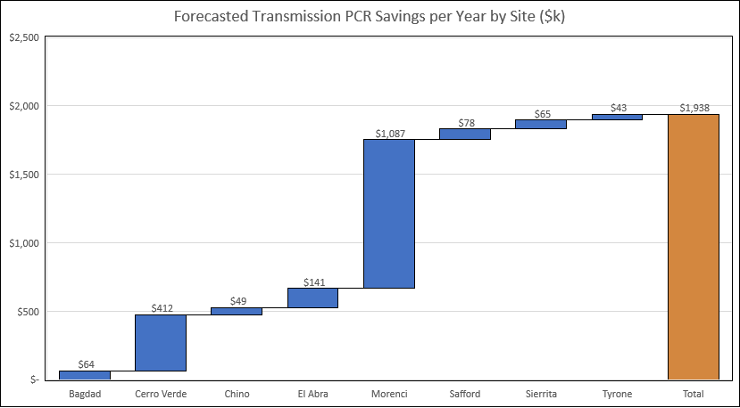
Forecasted Transmission PCR Savings per Year
PCR quantity is based off average number of PCRs needed per year using 2020 operating hours; actual numbers each year may be higher/lower than average
Total estimated FMA cost savings of $1.9MM/year
*Estimate based on Jan. 2021 average component costs, 2020 operating hours, and Oct. 2020 PCR intervals

Slide 25
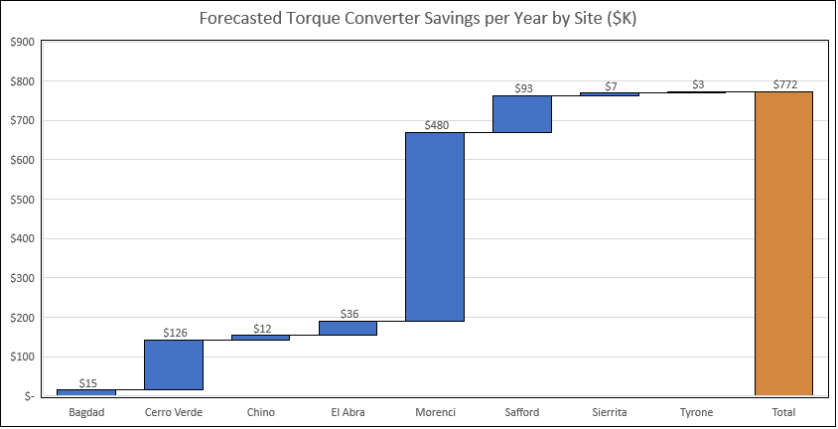
Forecasted Torque Converter PCR Savings per Year
PCR quantity is based off average number of PCRs needed per year using 2020 operating hours; actual numbers each year may be higher/lower than average
Total estimated FMA cost savings of $772k/year
*Estimate based on Jan. 2021 average component costs, 2020 operating hours, and Oct. 2020 PCR intervals
Notes:
Dave B.

Slide 26
Introduction
Maintenance
Intervention
Recommendations
Sustainability
Future Opportunities
Notes:
Antonio 26-27

Slide 27
Main PM Maintenance
As we did With the Feel the Fuel Burn Agile Team, we:
Reviewed all components (Transmission, Torque Converter, Differential, Final drive PM activities from all FMI sites
Consolidated all information and added input from Caterpillar and team SME’s
Provided a list of best practices for PM activities with a supporting document called the PM Book
PM Book content includes SOP’s for ‘high-risk’ components PM activities determined by SME’s as requiring extra focus while performing the job
Notes:
Antonio

Slide 28
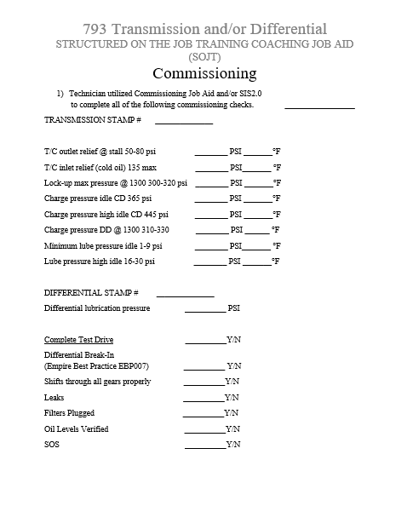
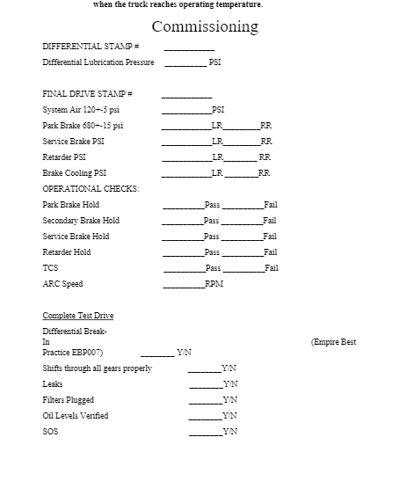
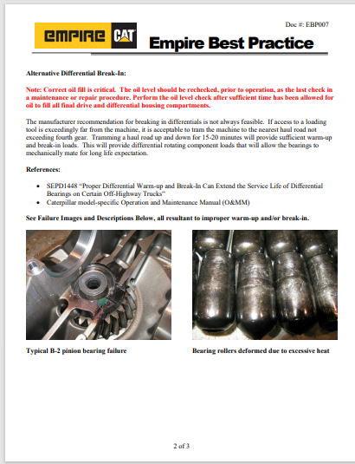
Commissioning/Break-in Procedures and Training Guides for Components - 793
Below are the links to the procedures and training guides to properly commission and break-in the components along with On-the-Job Training for the technicians.
Link to Differential Break In Procedure
Link to Transmission Commissioning Sheet
Link to Final Drive Commissioning Sheet
Link to Torque Converter Commissioning Sheet
Notes:
Willy & Trent

Slide 29
General Oil Best Practices
Best Practices:
Communicate best practices around oil drains and fill-ups
Communicate best practices around oil sampling.
Sample pump
Sample port
Monthly sampling strategy for bulk oil (hose reels and lube trucks) at the nozzle
Formal Lubrication Training for Maintenance Personnel
Sampling:
Implement training for oil sample process and the process to input data into LIMS
Create a site owner for LIMS data entry
Distribute oil sample alerts to a broader audience
Train people on the features of the HTHD
Notes:
Colin/Chet

Slide 30
Maintenance Interventions
It is crucial that we follow the maintenance best practices.
Torque Converters, Transmissions, and Differentials there is no beneficial internal component that we can change on site to extend life. (Engines we can change heads, injectors, etc.)
Final drives also have limited components we can change (first and second reductions) and we recommend not to change.
Notes:
Wayne/Antonio

Slide 31
Introduction
Maintenance
Intervention
Recommendations
Sustainability
Future Opportunities
Notes:
Cassandra

Slide 32
Life Models and Predictive Maintenance Models
Notes:
Mike B 32-34

Slide 33
Predictive Models
For each major HT component, we are building 2 models
Life Models → how much more life is left in the currently-installed component?
Predictive Maintenance Models → are there any warning signs for the health of the currently-installed component?
Current Status by component & model type:
Component | Life Model | Predictive Maintenance Model
Engine | BO Report in HTHD | BO Report in HTHD
Transmission | Model Completed | BO Report in HTHD
Right Final Drives | Model in Development | BO Report in HTHD
Left Final Drives | Model in Development | BO Report in HTHD
Torque Converters | (not started) | Model in Development
Differential | (not started) | (not started)
Notes:
Mike B

Slide 34
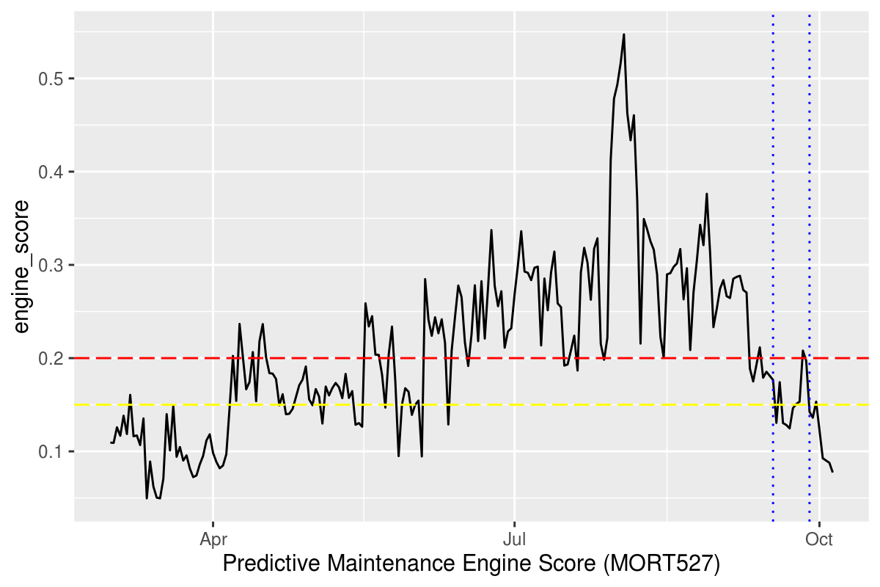
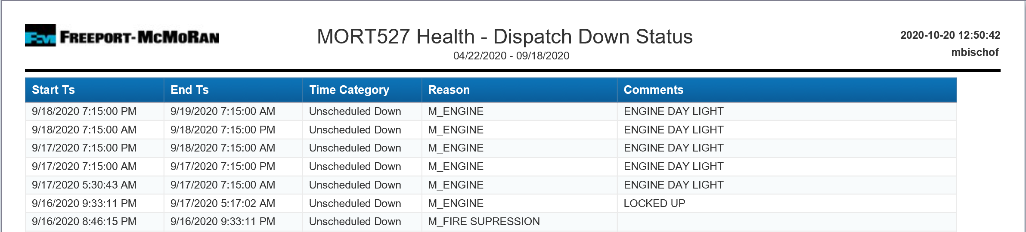
Case Study: MORT527 in September 2020
MORT527’s engine failed (“Engine Day Light”) in mid-September 2020.
The Engine PM Model alarmed in Red since early April 2020.
Notes:
Mike B.

Slide 35
Site Reports
Notes:
Trent/Tim/Russell/Jared 35-36

Slide 36
Feedback Methods – Standard Site Report
We must continue to build and refine our component life strategy in response to new data
This process begins with standardized Site Reports for failed Powertrain and major components
Component Failure
Complete Standardized Site Report
Add Completed Site Report to Data
Core Team Modifies Plan if Needed
Modified Plan Communicated to Sites
Notes:
Trent/Tim/Russell/Jared 35-36

Slide 37
Introduction
Maintenance
Intervention
Recommendations
Sustainability
Future Opportunities
Notes:
Chet 37-38

Slide 38
Condensed list of Currently Achievable Recommendations
Below is the finalized list of Component recommendations to be used at all sites going forward in order to Maximize Component Life.
Extending Component Life to 15000 Travel Hours
Extending oil drain intervals based on sample conditions before PM
Most up to date Duo Cones in finals and spindles
Most up to date Duo Cone install tooling
Standardized Ancillary Component PCR replacement list
Standardized component Midlife list
Extended Life brake disks to be used to maximize brake Life
Condition based oil changes from sample data to Extend oil life
This helps reduce. Freeport's waste and carbon footprint and potentially save Millions
Differential oil cooler installation (Already Happening at TRP but some were missed)
Notes:
Chet

Slide 39
Oil Recommendations
Notes:
Colin/Chet 39-42

Slide 40
Oil Data Summary
Oil samples from past 2 to 4 years analyzed to understand life of oil
Minimal indications of oil degradation at current maximum intervals
Differential/Final
PD6000 shows minimal degradation at 5000 hrs. in North America
3000 hrs. for Cerro Verde with current oil
6000 hrs. for El Abra with current oil
Transmission
Current data supports 2500 hrs. for North American sites
Current data supports 1500 hrs. for Cerro Verde
Current data supports 2000 hrs. for El Abra
Spindle
2500 hrs. achievable with PD6000 or Power Drive SAE 60 in North America
No data for El Abra, and only data from 500 hr. samples from Cerro Verde – possibility to extend significantly with testing
Notes:
Colin/Chet

Slide 41
Changing Attitudes Around Changing Oil
Condition based oil drain strategy starts here
Daily evaluation of Oil Sample Reports to identify when to change oil
Would not require major changes to PM plans.
Sample should be taken from 400-500 hours. Plan oil drains from results.
Training for sample information to help understand importance
Extending Transmission, Differential, Final, and Spindle oil drain intervals through condition-based changes could potentially save more than $3MM in North America alone.
Freeport’s Carbon Footprint
Estimated 845k gallon reduction in oil usage over life of components in North America
20MM lbs. reduction in CO2 emissions (based on EIA)
Notes:
Colin/Chet

Slide 42
Cost Savings Summary
Estimated Potential Cost Savings Breakdown
Safford – $0 savings (already doing condition-based oil changes)
Tyrone – $66k
Bagdad - $114k
Sierrita – $235k
Chino – $374k
Morenci - $2,209k
Example:
Differential oil extended drain example PD6000 |  |  |  | Average Differential Life 20,000 eng hours
Differential PD6000 | 2000hrs | Differential PD6000 | 5000hrs
# Trucks | 149 | # Trucks | 149
Gallons | 270 | Gallons | 270
Price/gallon | $8.15 | Price/gallon | $8.15
Times/comp life | 10 | Times/component | 4
Oil Cost/yr/truck | $22,005.00 | Oil Cost/yr/truck | $8,802.00
Oil Cost/fleet/yr | $3,278,745.00 | Oil Cost/fleet/yr | $1,311,498.00 | Difference $1,967,247.00
Notes:
Colin/Chet
Finals & Diff - $2200/oil change (270 gal)
Transmission - $290/oil change (60 gal)
Spindles - $140/oil change (17.1 gal)

Slide 43
Component Recommendations
Notes:
Wayne/Chet 43-44

Slide 44
Extending Component life recommendations condensed list
Our team realizes that there have been many updates to the duo cones
Ensure all sites and dealers are using most updated duo cones and installation tooling
Standardized list of components to replace at PCR and after Failures to ensure component longevity
Midlife PCR recommendations for drivelines, roto chambers and slack adjusters
Entire fleet to use Extended Life brake discs as a direct replacement of standard brake discs to aide in extending final drive life
All sites ensure that the most updated park brake release adjustment procedure is being followed to make sure park brakes are not dragging
Park brake pressures must be adjusted at the Left Rear wheel for proper release pressure. Verify park brake pressure at wheel replaced. (RENR8330) (SENR6343)
Notes:
Chet/Wayne

Slide 45
TRP Recommendations – Differential Oil Coolers
Notes:
Dave B 45-47

Slide 46
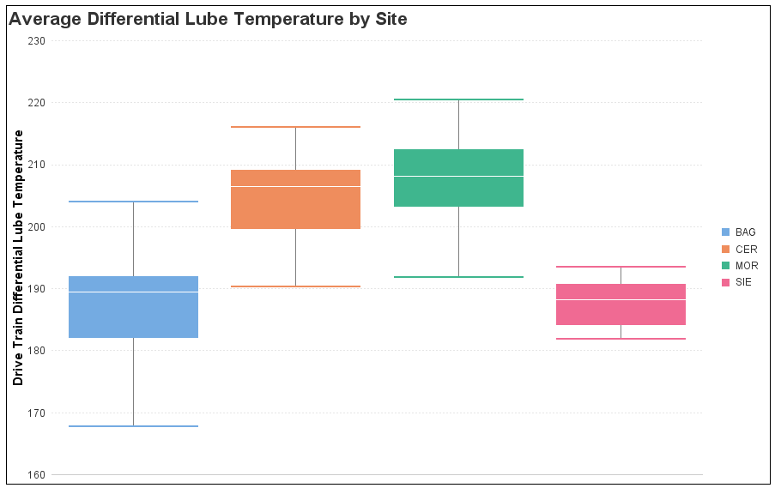
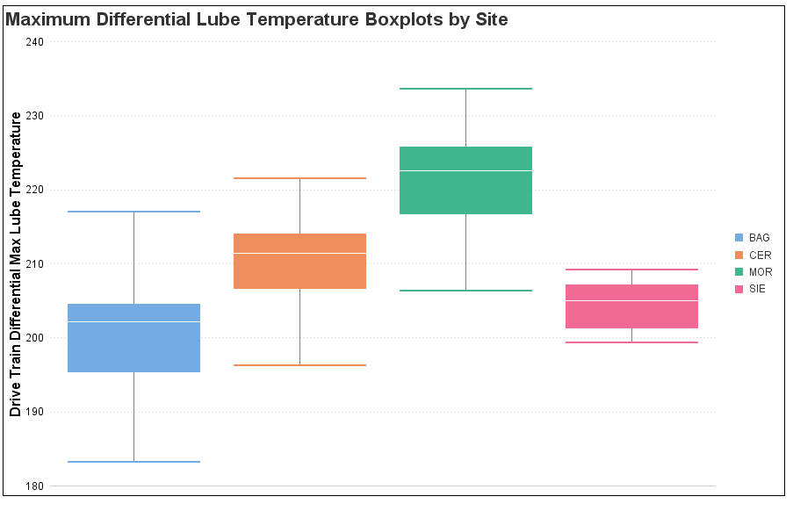
Do Our D-Model Fleets Exceed the Limit?
Boxplot data shows that during the summertime, average oil temperatures consistently exceed the threshold of 194° F consistently in the summertime particularly at sites with flat, high-speed runs (Morenci/CV)
The exception is Bagdad, who currently have differential oil coolers on all trucks except for T220
Notes:
Dave B.

Slide 47
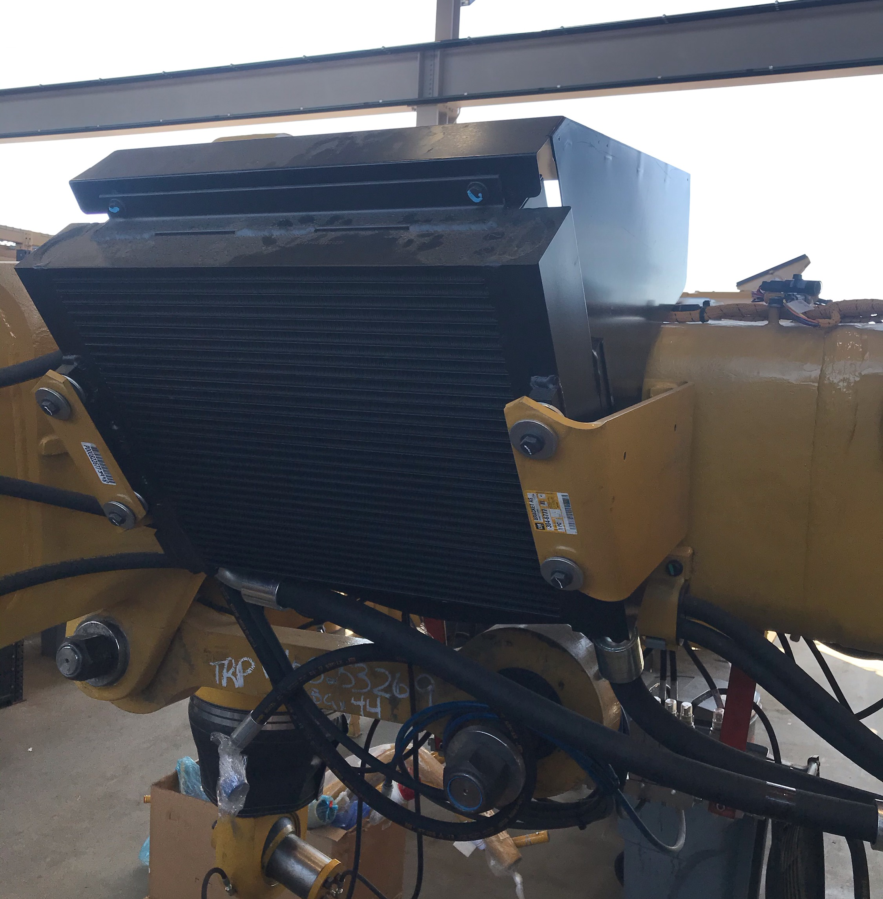
Differential Cooler Recommendations
Standardize installation of differential oil cooler package on all D-Model TRPs
Retrofit machines that have already gone through TRP but did not receive the update
Notes:
Dave B.

Slide 48
H&E Finals
Notes:
Diego 48-49

Slide 49
H&E Final Drive
OVERVIEW
H&E Final Drive is mainly a CAT Final Drive with addition of H&E improvements.
The process and time to R&I the final drive CAT are equal WITH H&E final drive.
The maintenance practices are equal between CAT and H&E, only have the difference in kidney looping. H&E requires this process for each independent components (final drive RH, Final drive LH and Differential and Differential oil coolers are ineffective.
Oil samples show that particle counts and wear are similar.
Bearing, gear and other parts are original CAT.
H&E finals do have a direct impact on isolating failures.
The pre-load procedure was a block due to H&E policy.
Recommendation is we continue to use Caterpillar finals.
Links: https://www.h-eparts.com/solutions/mining-solutions/birrana-enhancements-wheel-ends/
Notes:
Diego

Slide 50
Introduction
Maintenance
Intervention
Recommendations
Sustainability
Future Opportunities
Notes:
Tim 50-53

Slide 51
Site Communication/Transition Plan
Communicate to Management and Superintendents
MVP rollout & value
Frontline Supervisors/Planners
Value of work
All Truck Shop Techs
Use of PM books, commissioning guides and intervention tools
Implementation of recommendations and Best Practices
Importance of proper maintenance, Best Practices, and intervention
Value and purpose of increased work
Execute Best Practices
Feedback system
Positive recognitions
Notes:
Tim

Slide 52
CL Sustainability Team Charter
Opportunity
Establish a team that meets with all sites to monitor, answer questions, and share information between all sites and dealers
Expectations
Meet via teleconference bi-monthly to discuss data combining the FTFB and CL teams
Goal
Add to the success of the Component Life Project at all sites
Objectives
Provide a means by which all sites can gain and share information that will help to extend the life of all CAT Haul Truck components
Notes:
Tim

Slide 53
Proposed CL Sustainability Team
Site Product Owners
Site Product Owners
David Barnes
Dealer Representatives
Caterpillar
Operational Improvement
Eric Hansbraugh – BAG
Wayne Toney – Chino
Fernando Rivero –CV
Anibaldo Aracena – ABR
Willey Biggs – MOR
Robert Gray – MOR
Josh Wirsching
Jared Townley –Empire
Jorge Tokashiki –Ferreyros
Jorge Selti – Finning
Russell Flamm –Wagner
Diego Malaga – CV
Brady Norton – SAF
Tim Eldred - Wagner
Stakeholder: Manny Herrera
Antonio Corral – SIE
Chet Shiflet – SIE
Shawn Clarno – CMX
Jason Anderson - CMX
Royce Parra - TYR
Jimmy Tellez -MOR
Trent Reidhead -Empire
Maria Eugenia Morales - ABR
Pablo Garza-Barroso
Member of the FTFB sustainability team
Notes:
Tim

Slide 54
Tracking Value
Notes:
Diego 54-56

Slide 55
How do we track Value?
Utilize Sustainability Dashboard in Power BI to track key metrics across all sites
Ensure component maintenance costs are maintained
Track component life at each site in an easy-to-use format
Ensure component reliability is maintained
Customer feedback is key as we iterate on this report
Notes:
Diego

Slide 56
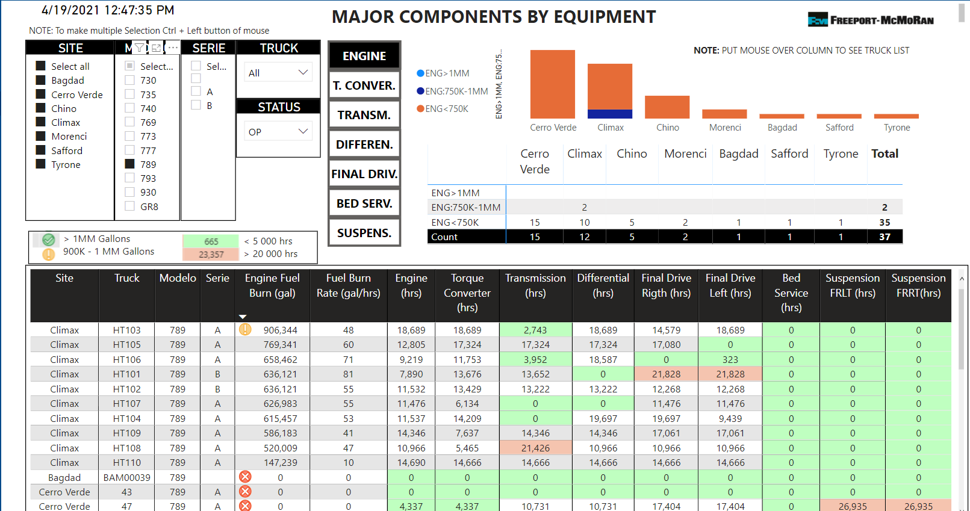
Power BI Component Overview MVP

Slide 57
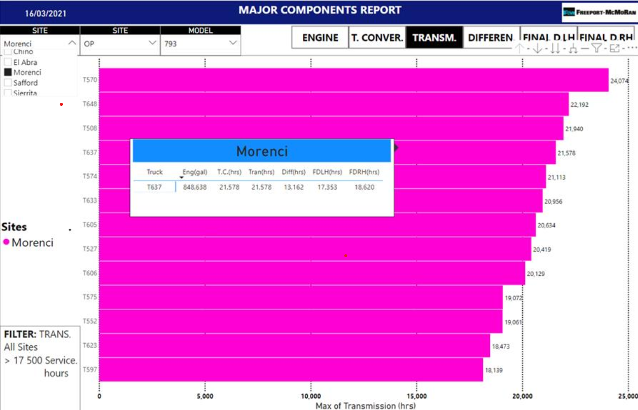
Ranked Components – High to Low MVP
Notes:
Diego

Slide 58
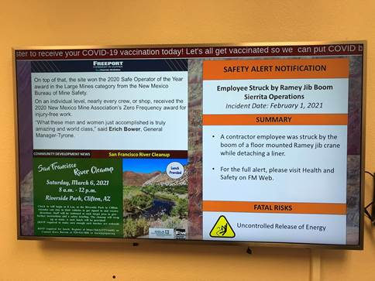
Communicating Team Goals to a Broader Audience
Utilize V-Net Screens onsite to communicate wins, value, and KPIs which will create some excitement and build a bit of friendly competition between sites
Work is underway with the corporate communications team to make this a reality
Notes:
Chet/Wayne 58-59

Slide 59

Our Ask: Own and Support this for your Site!
Your buy-in and continued support is critical to meeting our ambitious goal
Please communicate why we are making any changes to increase component life – show the value!
Let the core team know any doubts or setbacks so they can be addressed
Each site should form a small team to carry on component life work and communicate back to the Core Team through site Product Owners:
Site Dealer Representative
Site Sr. Planner
Site Supervisor
These efforts and collaboration on each site should tie in with the 1MM gallon fuel burn on engines from the Feel the Fuel Burn team.
Notes:
Chet/Wayne

Slide 60
Introduction
Maintenance
Intervention
Recommendations
Sustainability
Future Opportunities

Slide 61
Future Opportunities Overview
Notes:
Chet/Colin 66-67

Slide 62

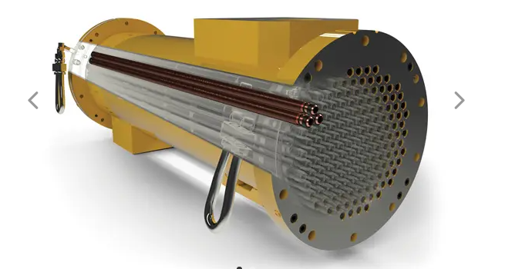
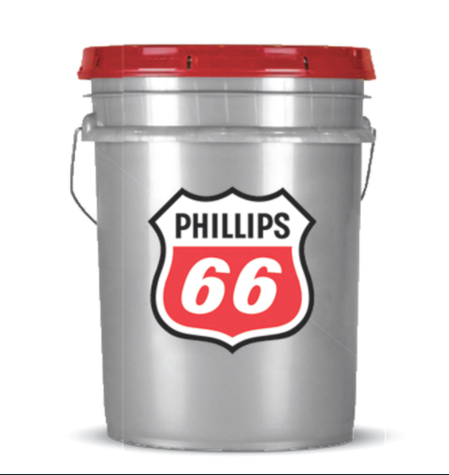
Things We Found Out Along the Way
Extensive analyses have generated future opportunities for improving HT reliability and are highlighted below. Details are in the appendix
Syncon Synthetic differential fluid
Synthetic differential fluid test in Cerro Verde
Automated oil sample data entry system (SAP/LIMS interaction)
B/C model differential oil cooler test
On-Board kidney looping
793C model transmission in 793B model trucks
Brake cooler improvements
Mesabi brake coolers
Brake cooler screens
D-Model Extra-Retarding packages
Diamond Like Carbon Coated bearing for front and rear wheel groups
Currently in some front wheel groups in Chino
Standardize the use of Wiggins Quick Connect fittings at all sites for all equipment
Link to Future Opportunity details
Notes:
Chet/Colin

Slide 63
MVP Site Rollout (Tentative)
March 24th/ 25th
Morenci
March 26th
Tyrone
March 30th
Safford
March 31st
Sierrita
April 5th
Bagdad
April 6th
El Abra
April 7th/8th
Cerro Verde
April 13th
Chino
April 20th
Climax

Slide 64
Comments and Questions
Notes:
All

Slide 65
Appendix

Slide 66
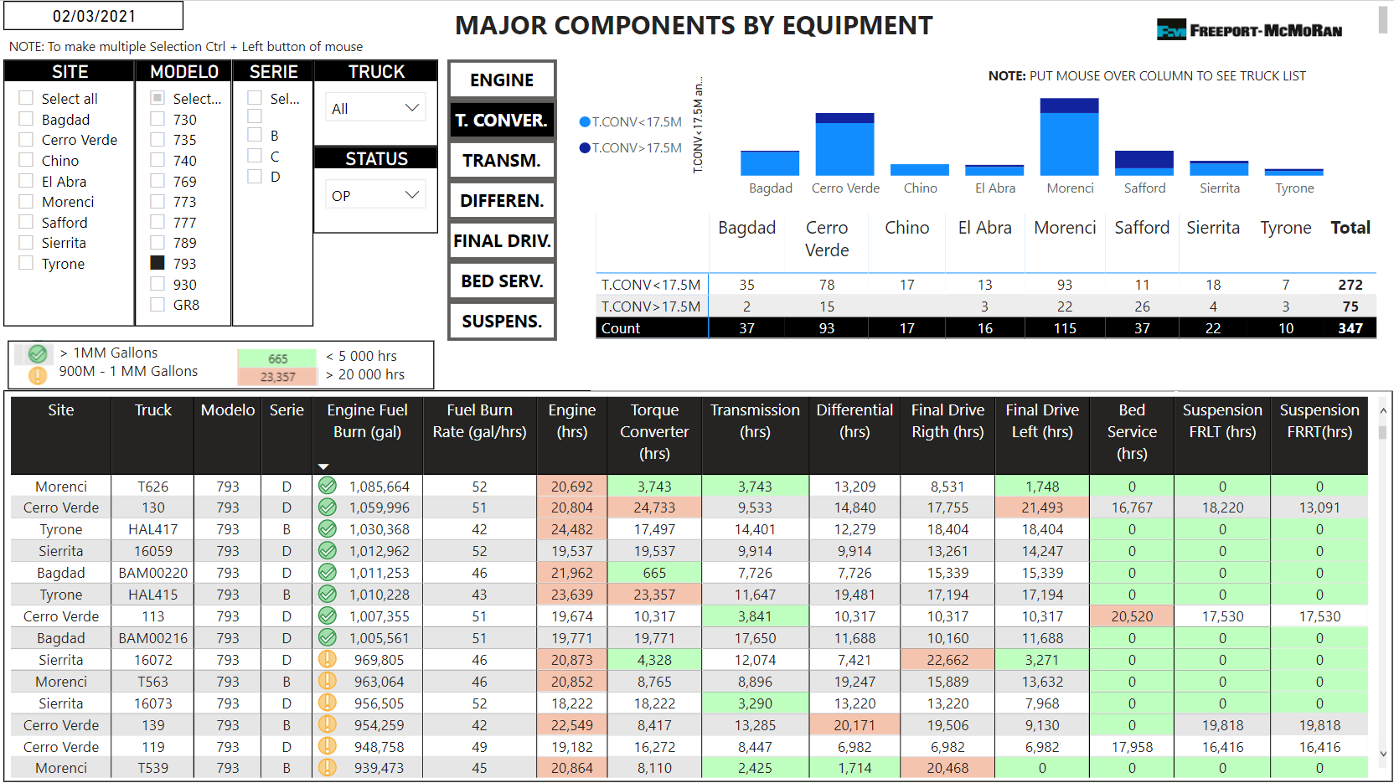
Power BI Component Overview MVP
Notes:
Diego

Slide 67
Overview of Life Models
Building a Component Life Model
Get data on historical components with install and removal dates
Calculate their life using the correct life metric → for example: 4 years of differentials at all sites & calculated travel hours
Get data to describe the working conditions during the life of the component → for example: oil data, excessive idle data & operating conditions for engines
Build statistical model predicting component life with these condition variables
Solicit SME input to finalize model → for example: exclude counterintuitive variables
Notes:
Attend Meeting with Christine & Notes

Slide 68
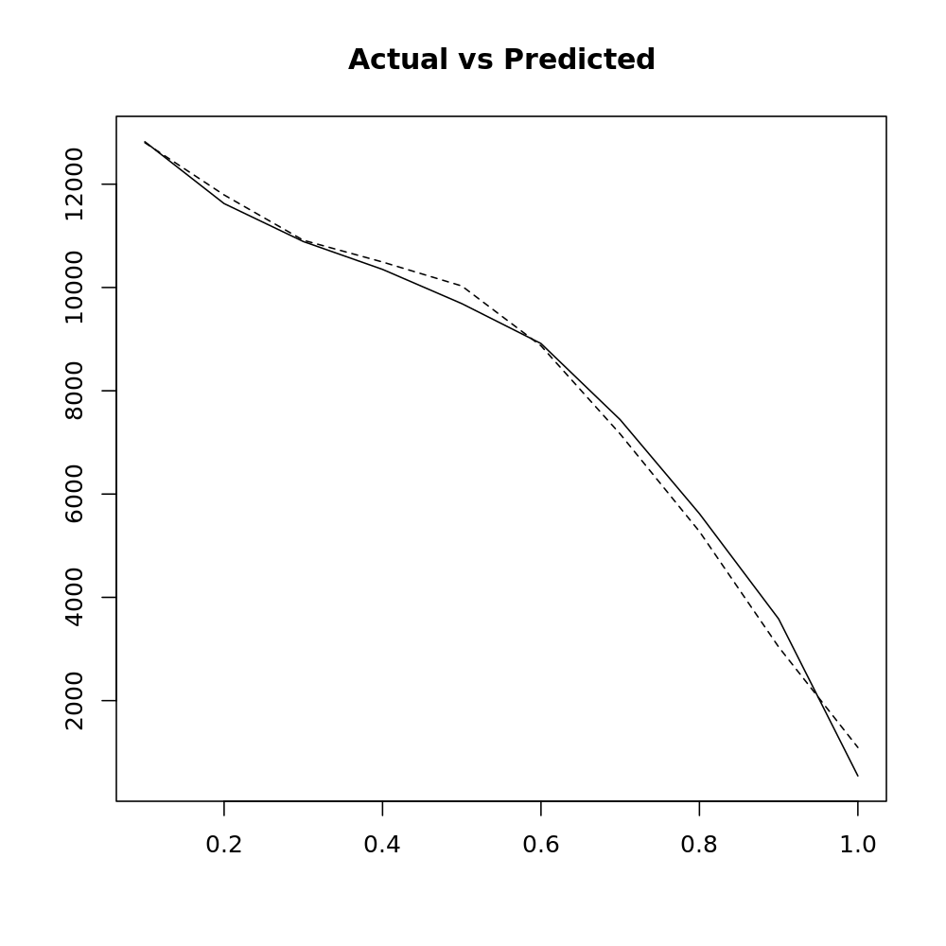
Overview of Life Models
Model Diagnostics for Component Life Model: → Actual component life closely tracks predicted component life
Notes:
Attend Meeting with Christine & Notes

Slide 69
Overview of Predictive Maintenance Models
A “performance window” methodology is used to identify these major maintenance events for model building & model usage:
Model Building
For each calendar month, determine whether an event has happened.
Attach the dataset of the predictive variables for the 15th of the previous month
Model Usage (“Predictions”)
The predictions will give user 15–45 days to preemptively service the component
Calendar Month
(Prediction Window for Model)
15th of Previous Month
time
Data Window for all Modeling Variables
Maintenance Event ?
(Yes / No)
Recent Data
BO Report today (“Model Prediction”)
≈ 15-45 days to react to prediction
Notes:
Attend Meeting with Christine & Notes

Slide 70
Oil Dialysis / Kidney Loop
Current Differential Kidney Loop Intervals
Site | Interval
Bagdad | 500 hours
Chino | 460 hours
Cerro Verde | 660 hours
Climax | N/A
El Abra | 350 hours
Morenci | 1750 hours or N/A
Safford | 500 hours
Sierrita | 500 hours
Tyrone | 500 hours
Currently only El Abra kidney loops transmission oil (at 350 hours)

Slide 71
Current Oil in Components
Site | Hydraulics | Transmission | Front Spindles | Rear Axle (Final Drive and Differential)
Bagdad | P66 PowerDrive SAE 30 | P66 PowerDrive SAE 30 | P66 PowerDrive 6000 | P66 PowerDrive 6000
Chino | P66 PowerDrive SAE 10 | P66 PowerDrive SAE 30 | P66 PowerDrive 6000 | P66 PowerDrive 6000
Climax | P66 PowerDrive SAE 10 | P66 PowerDrive SAE 30 | P66 PowerDrive 6000 | P66 PowerDrive 6000
Morenci | P66 PowerDrive SAE 30 | P66 PowerDrive SAE 30 | P66 PowerDrive 6000 | P66 PowerDrive 6000
Safford | P66 PowerDrive SAE 10 | P66 PowerDrive SAE 30 | P66 PowerDrive SAE 60 | P66 PowerDrive 6000
Sierrita | P66 PowerDrive SAE 10 | P66 PowerDrive SAE 30 | P66 PowerDrive 6000 | P66 PowerDrive 6000
Tyrone | P66 PowerDrive SAE 10 | P66 PowerDrive SAE 30 | P66 PowerDrive 6000 | P66 PowerDrive 6000
Cerro Verde | Shell Spirax S4 CX SAE 10 | Shell Spirax S4 CX SAE 30 | Shell Spirax S5 CFD M SAE 60 | Shell Spirax S5 CFD M SAE 60
El Abra | Mobil Mobiltrans HD SAE 10 | Mobil Mobiltrans AST | Mobil Mobilube XFD SAE 50 | Mobil Mobilube XFD SAE 50

Slide 72
Current Oil Change Intervals
Site | Hydraulics | Transmission | Front Spindles | Rear Axle (Final Drive and Differential)
Bagdad | 3,800 Hours | 2,500 Hours | 2,500 Hours | 3,800 Hours
Chino | 920 Hours | 920 Hours | 500 Hours | 1848 Hours
Climax | 1000 Hours | 1000 Hours | 250 Hours | 2000 Hours
Morenci | 1,600 Hours or SOS Condition | 1,600 Hours or SOS Condition | 1,600 Hours or SOS Condition | 2,000 Hours or SOS Condition
Safford | 20K Hours PCR or SOS Condition | 20K Hours PCR or SOS Condition | 20K Hours PCR or SOS Condition | 20K Hours PCR or SOS Condition
Sierrita | 1,000 Hours | 2,000 Hours | 500 Hours | 3,000 Hours
Tyrone | 1,000 Hours | 1,000 Hours | 500 Hours | 5,000 Hours
Cerro Verde | 2,600 Hours | 1,300 Hours | 500 Hours | 2,600 Hours
El Abra | 2,000 Hours | 2,000 Hours | 250/500 Hours | 4,000 Hours

Slide 73
Transmission Oil – North America
5000 Samples Analyzed (2019 and 2020 Oil Samples)
Team reviewed current oil specifications, sample results and specific factors that determine the oil degradation with the Safford Oil Lab and P66 team
No indication of Oil Degradation at current max drain interval – 2500 Hours
Oil Hours | Viscosity 100 | Viscosity 40 | Ca | P | Zn
0-500 | 10.85 | 92.08 | 2495 | 871 | 1078
500-1000 | 10.87 | 92.32 | 2502 | 872 | 1074
1000-1500 | 10.82 | 91.66 | 2500 | 857 | 1062
1500-2000 | 10.78 | 91.44 | 2541 | 873 | 1079
2000+ | 10.80 | 91.47 | 2543 | 875 | 1081

Slide 74
Transmission Oil – Cerro Verde
1700 Samples Analyzed (2019 and 2020 Oil Samples)
No indication of Oil Degradation at current max oil hours – 1500 Hours
Shell Spirax S4 CX SAE 30:
Meets TO-4 specifications
Viscosity at 40C: 93.9 cSt
Viscosity at 100 C: 10.9 cSt
Viscosity Index: 100
Additive Package Element Range
Calcium: 3000 to 3600 ppm
Phosphorus: 750 to 1000 ppm
Zinc: 1000 to 1400 ppm
Oil Hours​ | Viscosity 100​ | Ca​ | P​ | Zn​
0-500​ | 10.87 | 3261.27 | 877.77 | 1249.37
500-1000​ | 10.92 | 3452.07 | 877.23​ | 1315.51​
1000-1500​ | 10.89 | 3440.49 | 873.61 | 1301.90​
1500+ | 10.89 | 3472.74 | 860.50​ | 1321.20

Slide 75
Transmission Oil – El Abra
Team Member
Type (Mobil Trans AST Multigrade, Meets specifications Caterpillar TO-4M)
Samples analyzed from 2017 to 2020
Oil Change 2000 hours or condition
Oil dialysis / Kidney lube each 350 hours
Analysis.
Stable wear elements
Controlled contamination
Ferrous density with a downward trend
Viscosity without variations

Slide 76

Differential Oil – North America
P-66 PowerDrive 6000
Meets CAT FD-1
Viscosity at 40C: 344 cSt
Viscosity at 100 C: 25.8 cSt
Viscosity Index: 98
Additive Package Element Range
Boron: 70 to 120 ppm
Calcium: 200 to 500 ppm
Phosphorus: 200 to 500 ppm
5000 hour interval is minimum recommendation with PD6000. Slight oil degradation in samples with increasing hours of runtime, but the viscosity is likely affected by Duo-Cone Leaks. No additive loss.
Hours | NOx | Oxidation | ISO4 | ISO6 | ISO14 | PQ | TAN | V100 | V40 | B | Ca | Cu | Fe | P | Si
0-500 | 1.17 | 2.28 | 23.36 | 21.09 | 15.84 | 25 | 0.71 | 24.9 | 330.5 | 107 | 385 | 2 | 23 | 343 | 8
500-1000 | 1.40 | 2.71 | 23.02 | 20.75 | 15.62 | 29 | 0.69 | 24.8 | 328.4 | 102 | 413 | 3 | 26 | 352 | 7
1000-1500 | 1.62 | 4.05 | 22.98 | 20.71 | 15.47 | 31 | 0.72 | 24.6 | 323.0 | 102 | 440 | 4 | 32 | 359 | 8
1500-2000 | 1.60 | 4.23 | 22.86 | 20.52 | 15.33 | 34 | 0.76 | 24.6 | 324.3 | 105 | 435 | 3 | 35 | 362 | 7
2000-2500 | 1.87 | 5.16 | 22.80 | 20.49 | 15.09 | 49 | 0.79 | 24.5 | 322.5 | 102 | 465 | 5 | 40 | 365 | 8
2500-3000 | 1.79 | 6.01 | 22.88 | 20.35 | 14.68 | 23 | 0.79 | 24.4 | 318.8 | 104 | 460 | 4 | 41 | 366 | 8
3000-3500 | 1.91 | 5.96 | 22.52 | 20.19 | 14.73 | 40 | 0.81 | 24.4 | 321.6 | 107 | 456 | 4 | 42 | 370 | 8
3500-4000 | 1.91 | 5.67 | 22.03 | 19.62 | 14.69 | 16 | 0.82 | 24.2 | 317.3 | 108 | 500 | 5 | 41 | 382 | 7
4000+ | 1.72 | 5.79 | 22.23 | 19.74 | 14.19 | 25 | 0.78 | 23.7 | 308.6 | 102 | 501 | 4 | 42 | 381 | 8
Hours N/A | 1.87 | 4.36 | 23.11 | 20.83 | 15.66 | 32 | 0.83 | 24.7 | 324.7 | 98 | 476 | 4 | 41 | 364 | 11

Slide 77

Differential Oil – Cerro Verde
Shell Spirax S5 CFD M SAE 60
Meets CAT FD-1
Viscosity at 100 C: 22.8-25.2 cSt
Additive Package Element Range
Boron: 70 to 120 ppm
Calcium: 150 to 500 ppm
Phosphorus: 150 to 500 ppm
3000 hour interval is minimum recommendation, with testing to extend it further. Slight oil degradation in samples with increasing hours of runtime. No indication of additive depletion.
Hours | Oxidation | ISO4 | ISO6 | ISO14 | PQ | Viscosity 100 | B | Ca | Cu | Fe | P | Si
0-500 | 9.7 | 22.2 | 20.0 | 14.7 | 45 | 22.9 | 84 | 331 | 2 | 20 | 271 | 5
500-1000 | 10.3 | 22.4 | 20.1 | 14.7 | 32 | 23.8 | 87 | 243 | 2 | 20 | 256 | 5
1000-1500 | 11.0 | 22.1 | 19.7 | 14.1 | 35 | 23.8 | 86 | 248 | 3 | 23 | 255 | 5
1500-2000 | 11.2 | 22.4 | 20.2 | 14.6 | 119 | 23.6 | 87 | 258 | 3 | 29 | 256 | 6
2000-2500 | 11.6 | 22.5 | 20.2 | 14.3 | 30 | 23.6 | 85 | 266 | 3 | 27 | 256 | 5
2500-3000 | 12.2 | 21.5 | 19.1 | 12.8 | 20 | 23.5 | 85 | 287 | 4 | 29 | 258 | 5

Slide 78
Differential Oil – El Abra
Team Member
Samples analyzed from 2017 to 2020
Oil Change Currently 6000 hours or condition
Oil dialysis / Kidney lube each 350 hours
Stable wear elements
Controlled contamination
Ferrous density with a downward trend
Viscosity without variations

Slide 79
Spindle Oil Recommendations
Data proves that we can extend spindle oil drain intervals out to 2500hrs in North America
Oil Hours | NOx | Oxidation | PQ | Viscosity 100 | Viscosity 40 | B | Ca | Fe | Ni | P | Si
0-500 | 0.3 | 0.4 | 17 | 24.7 | 327.2 | 104 | 390 | 19 | 3 | 340 | 19
500-1000 | 0.8 | 0.6 | 51 | 24.7 | 325.6 | 105 | 424 | 35 | 3 | 357 | 14
1000-1500 | 0.8 | 0.9 | 81 | 24.5 | 319.6 | 106 | 460 | 74 | 10 | 374 | 18
1500-2000 | 0.7 | 0.8 | 58 | 24.8 | 327.2 | 110 | 421 | 46 | 4 | 363 | 15
2000+ | 0.7 | 1.0 | 93 | 24.7 | 324.8 | 107 | 433 | 101 | 6 | 359 | 18
Site | Viscosity Issues | Wear Issues (Fe or PQ) | Contamination (Water or Si)
Bagdad | 6.36% | 10.14% | 1.94%
Chino | 28.64% | 5.40% | 2.75%
Climax | 4.80% | 6.40% | 0.80%
Morenci | 24.15% | 28.66% | 2.68%
Safford | 21.25% | 11.92% | 3.13%
Sierrita | 4.15% | 1.12% | 0.52%
Tyrone | 61.35% | 9.61% | 5.49%
NA Overall | 21.75% | 16.61% | 2.61%

Slide 80
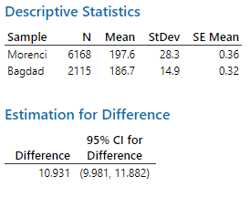
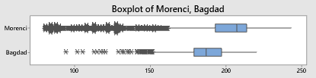
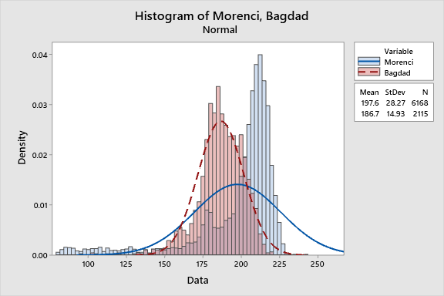
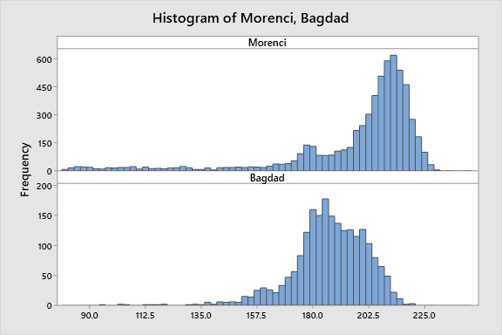
Is there a difference? The data says there is!

Slide 81
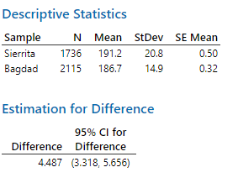
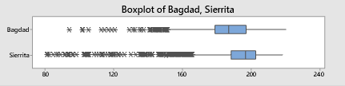
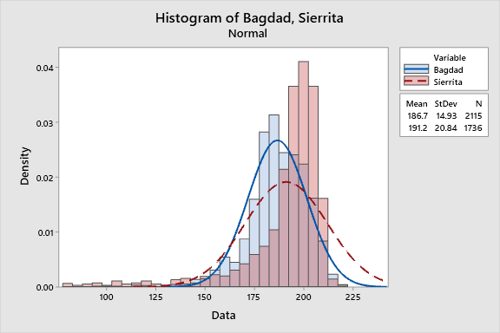
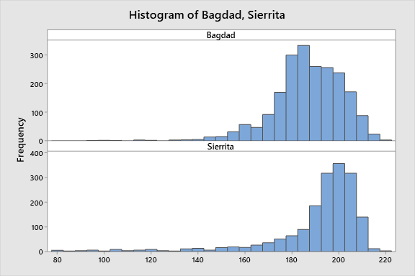
Without Outliers – BAG vs SIE

Slide 82
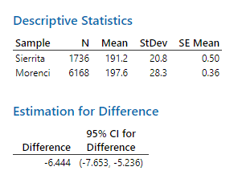
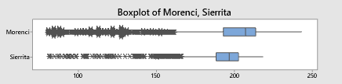
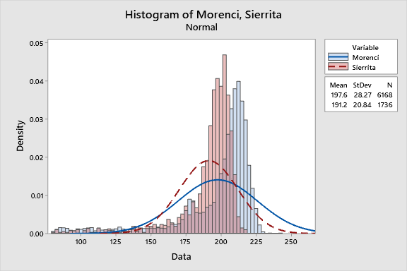
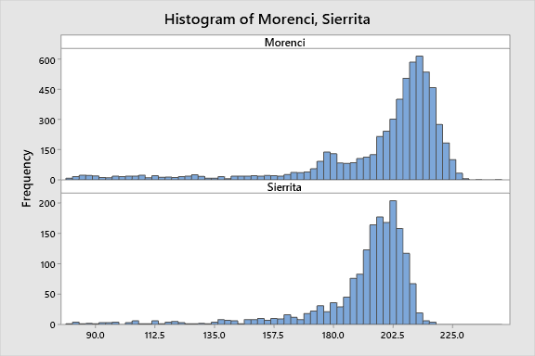
Without Outliers – MOR vs SIE

Slide 83
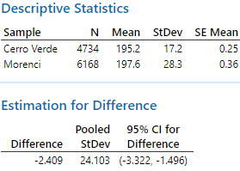
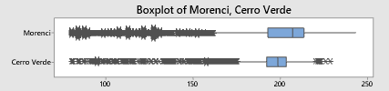
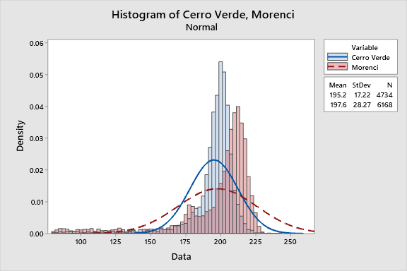

CV Vs. Morenci

Slide 84
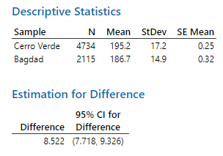

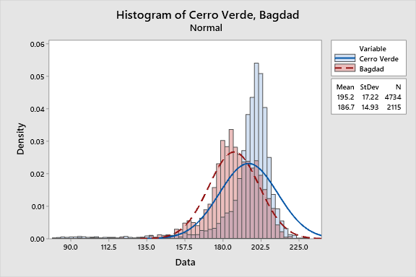
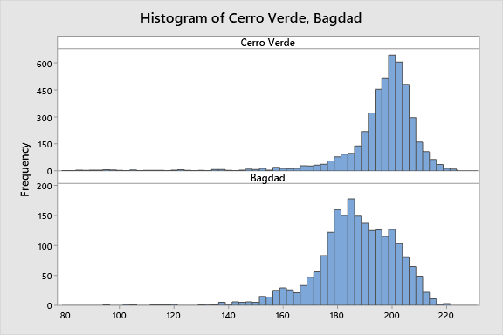
CV Vs. Bagdad

Slide 85
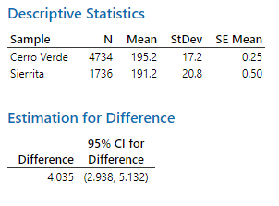

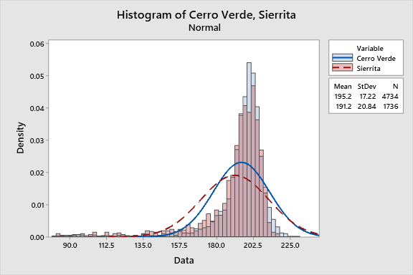
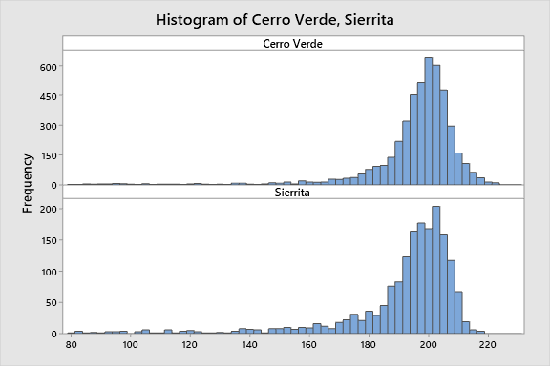
CV Vs. Sierrita

Slide 86
Duo Cone
Following are old duo cone numbers and the most updated duo cones offered.
 | WITH REVERSE FLOW - CURRENT |  | WITHOUT REVERSE FLOW
STANDARD | FRONT |  | FRONT
 | WHEEL GP | 470-8606 | WHEEL GP | 280-2056
 | OUTER SEAL | 563-8599 | OUTER SEAL | 563-8599
 | INNER SEAL | 421-8985 | INNER SEAL | 421-8974
 | REAR |  | REAR
 | WHEEL GP | 280-2051 | WHEEL GP | 280-2051
 | OUTER SEAL | 563-8599 | OUTER SEAL | 563-8599
 | INNER SEAL | 423-2091 | INNER SEAL | 423-2091
XLP | FRONT |  | FRONT
 | WHEEL GP | 280-2057 | WHEEL GP | 280-2057
 | OUTER SEAL | 423-2089 | OUTER SEAL | 423-2089
 | INNER SEAL | 423-2091 | INNER SEAL | 423-2091
 | REAR |  | REAR
 | WHEEL GP | 280-2052 | WHEEL GP | 280-2052
 | OUTER SEAL | 423-2089 | OUTER SEAL | 423-2089
 | INNER SEAL | 423-2091 | INNER SEAL | 423-2091
Old Seal | Replaced With Seal
378-0592 | 423-2089
314-4130 | 563-8599
365-4922 | 423-2091
314-4126 | 421-8974
365-4924 | 421-8985
Summarize recommendations and move this slide to the Appendix- Wayne

Slide 87
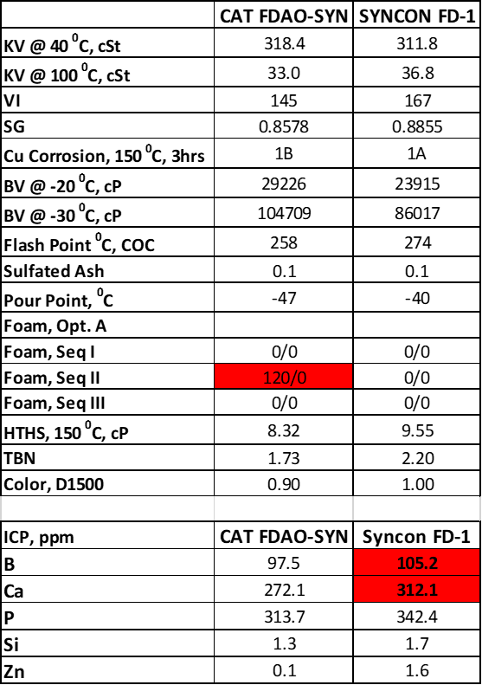
Physical and Chemical QC tests
Syncon Final Drive advantages:
Higher Kinematic Viscosity @ 100°C for better high temp performance
Higher Absolute Viscosity (HTHS @ 150°C)
Lower Brookfield Viscosity at -20, -30°C for better low temp performance
Better foam control
Provided by P66 – Competitive Benchmarking

Slide 88
Oxidation Tests
RPVOT (Rotating Pressure Vessel Oxidation Test):
Testing conditions: 150 ⁰C; 90 psi; in the presence of water and copper catalyst coil
Conclusion: SYNCON Final Drive has slightly better performance versus CAT FDAO-SYN
PDSC (Pressure Differential Scanning Calorimetry):
Testing conditions: 500 psi, 190 ⁰C; measures oxidation induction time (OIT)
Conclusion: SYNCON Final Drive has significantly better performance than CAT FDAO-SYN
Provided by P66 – Competitive Benchmarking

Slide 89
Friction and Wear Tests
1. HFRR (High Frequency Reciprocating Rig; ASTM D6079)
2. Four Ball Wear Test (ASTM D4172)
Conclusions: The basic friction and wear properties of these fluids are very similar (all use the same additive system)
Provided by P66 – Competitive Benchmarking
Notes:
Comparison also includes our conventional FD-1 (non-synthetic) PowerDrive 6000

Slide 90
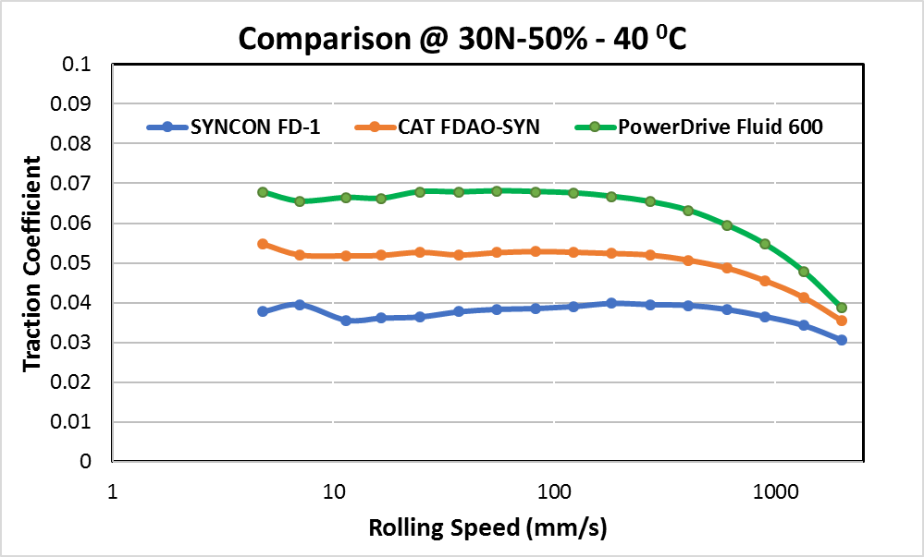
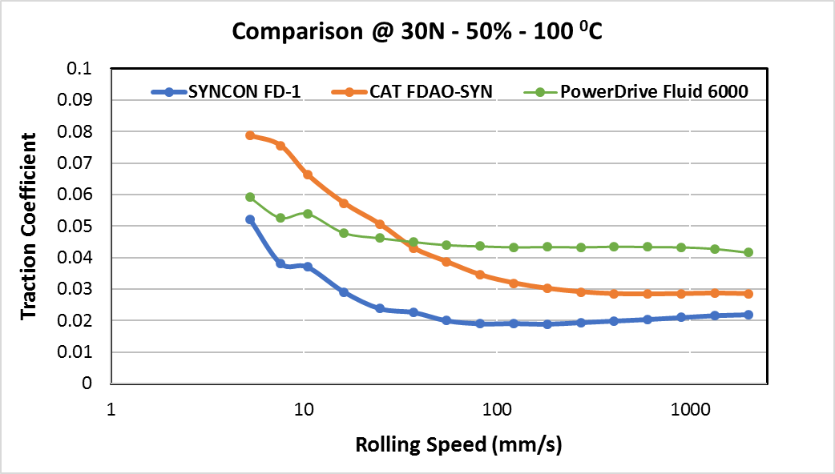
MTM Stribeck Curve
Pulling away from the shovel
Loaded on uphill grade
Loaded on level ground
SYNCON Final Drive has the lowest friction coefficient at the testing conditions
Should result in lower component temperatures and improved fuel efficiency
Provided by P66 – Competitive Benchmarking

Slide 91
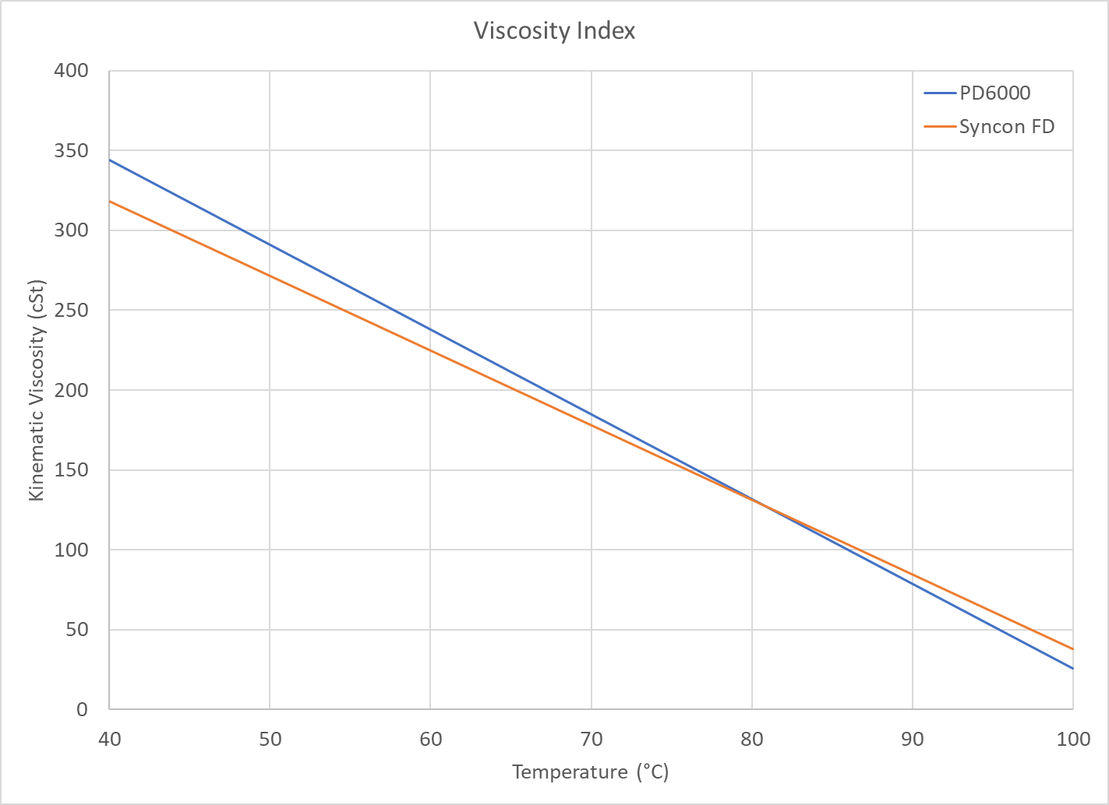
Viscosity Comparison
Viscosity Index
Syncon Final Drive – 170
PD6000 – 98
Viscosity
Syncon Final Drive
318 cSt @ 40C
38 cSt @ 100C
PD6000
344 cSt @ 40C
25.8 cSt @ 100C
Notes:
Effective Operation Temperatures: Syncon FD – down to 120 F, PD6000 – down to 140 F

Slide 92
Background and Test Plan
Syncon Final Drive Oil in Sierrita Haul Truck 16064 Differential and Final Drives
Test Started on or about January 15, 2019 (still ongoing)
Components involved in testing are two (2) wheel group assemblies built in the Empire CRC facility, with all F model gears, and a Torrington bearing differential.
The differential housing prepared to ensure a clean start and painted with a suitable paint, bright white in color.
Oil Samples and Magnetic Plugs taken every 250 hours (Standard Oil Tests)
P66 to perform RULER testing at 750 hour intervals
Same kidney loop schedule as other trucks – 500 hrs (dedicated kidney loop for Syncon FD)
Compare to a truck with PD6000 rebuilt at same time (16057)

Slide 93
Testing Details/Comments
Incorrect magnetic plugs used initially (too long, not OEM, rare earth)
Metallurgical analysis indicated debris was not bearing or gear wear
2/12/19 inspection indicated no damage to component
Duo Cone Seal Leaks
Minor leak in Right Final (slight viscosity loss) inspected on 5/31/19
Truck continued to operate, topped off with more oil (~30 gal)
More substantial leak in Left Final (continual viscosity loss)
Forced repair and replacement of oil on 10/30/19 (with 5923 hours on oil)
Inspection showed component in excellent condition

Slide 94
Results
Currently 14,655 hours on components (as of 1/26/2021)
RULER Results
Syncon Final Drive
3664 hours – 90% (taken 7/15/2019)
5498 hours – 90% (taken 10/10/2019)
6059 hours – 97% (taken 9/9/2020 from 2nd batch of oil)
7414 hours – 88% (taken 11/17/20 from 2nd batch of oil)
Powerdrive 6000
2100 Hours – 79%

Slide 95
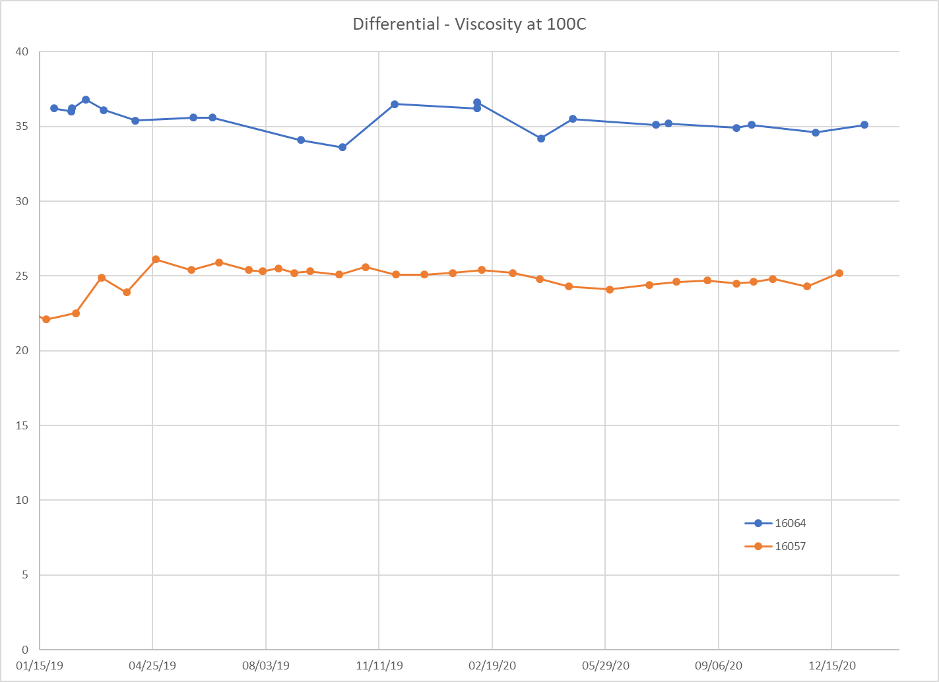
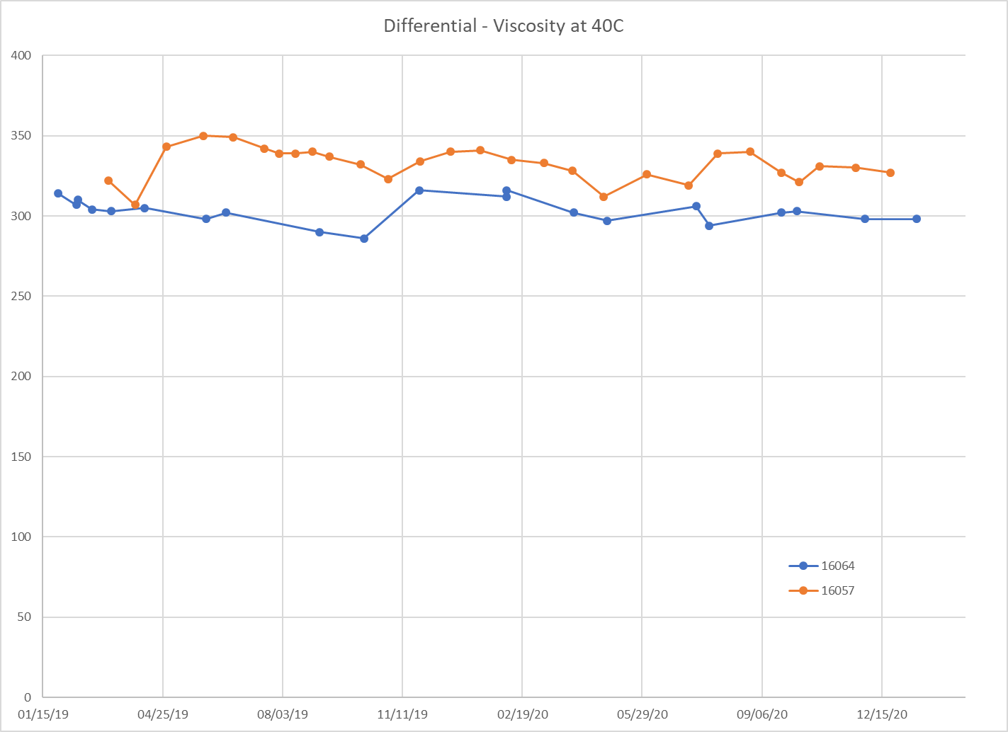
Viscosity

Slide 96

Wear and ISO
Better PQ results (lower wear generation)
8 average for HT64
16 average for Sierrita fleet
Comparable Iron wear
33 ppm average for Sierrita fleet
35 ppm for HT64
Better ISO Code results to rest of fleet
HT64 – 21.5/19.3/15 average
Sierrita fleet – 22.5/20/15 average

Slide 97

Differential Oil Temperature Sierrita D Models
HT64 Differential Oil Temperature running 5°F cooler in Summer 2020 (on average) compared to rest of 793Ds in Sierrita
Notes:
5.1 F Difference

Slide 98
Syncon FD1 Costs
 | PD6000 Oil Volume (2019) | Cost (at 2021Q2 price)
Tyrone | 5697 | $ 50,931.18
Morenci | 135942 | $ 1,215,321.48
Chino | 41512 | $ 371,117.28
Sierrita | 19345 | $ 172,944.30
Bagdad | 31894 | $ 285,132.36
Safford | 9500 | $ 84,930.00
Climax | 9900 | $ 88,506.00
Total | 253790 | $ 2,268,882.60
Average Interval | Syncon FD Yearly Cost | PD6000 Yearly Cost | Yearly Volume of Oil
2000 | $ 5,883,671.52 | $ 2,537,386.56 | 283824
3000 | $ 3,922,447.68 | $ 1,691,591.04 | 189216
4000 | $ 2,941,835.76 | $ 1,268,693.28 | 141912
5000 | $ 2,353,468.61 | $ 1,014,954.62 | 113530
6000 | $ 1,961,223.84 | $ 845,795.52 | 94608
7000 | $ 1,681,049.01 |  | 81093
8000 | $ 1,470,917.88 |  | 70956
9000 | $ 1,307,482.56 |  | 63072
10000 | $ 1,176,734.30 |  | 56765
Notes:
288 Trucks, 270 gal/truck, 7300 hrs/yr operation

Slide 99

Comparison – Caterpillar Recommended Cleanliness Targets Vs. Actual Average ISO Counts
David Barnes
Average Transmission Oil ISO Count (2020)
Caterpillar recommended target for fill oils – hydraulic, transmission, and final drive is ISO 16/13 or cleaner.
Cass- Finish formatting slides
Site | ISO4 | ISO6 | ISO14 | K/L?
Bagdad | 20 | 18 | 14 | No
Cerro Verde | 20 | 18 | 13 | No
Chino | 20 | 18 | 14 | No
Climax | 19 | 18 | 14 | No
El Abra | 20 | 16 | 12 | Yes
Morenci | 22 | 21 | 17 | No
Safford | 19 | 18 | 14 | No
Sierrita | 20 | 19 | 15 | No
Tyrone | 22 | 20 | 16 | No
Sites meeting CAT Cleanliness Spec (18/15)
Bagdad
Cerro Verde
Chino
El Abra
Safford
Climax
Are there best practices used at these sites that can help Morenci, Sierrita, & Tyrone achieve CAT standards for oil cleanliness?

Slide 100
Total Forecasted Components Q4 2020 vs. CL Forecast
Highlight Difference on the side & add actual component removals

Slide 101
Total Forecasted Downtime to Replace Components – Q4 2020 vs. CL Forecast
Highlight Difference on the side & add actual component removals

Slide 102
Total Forecasted Man Hours to Replace Components – Q4 vs. CL Forecast

Slide 103
Total Forecasted Cost Deferrals Q4 vs. CL Forecast
Highlight Difference on the side & actual component removals

Slide 104

Ranked Components – High to Low

Slide 105
Syncon FD-1 Test Summary
Tested on Sierrita HT64 since Jan 15, 2019 (close to 16k hours on components)
~10,000 hours on Oil (changed once due to duo cone leak)
Syncon Final Drive is a better oil for CAT 793 Final Drives and Differentials
Longer Oil Life (3x Oil Life)
Lower wear generation (PQ average half of fleet)
Better Viscosity Index
Better oil performance at high and low temperatures
Slight decrease in component operating temperature (5 F in Summer)
Cost: 2.3x cost of PD6000 ($20.73/gal vs $8.94/gal)
Challenges
Duo Cone Seal Leaks
Leaks that can affect viscosity need to be addressed promptly
Cannot replace all 60w oil at sites
Cannot be used in "Wet Brakes" (same as PD6000)

Slide 106
Future Opportunities for Syncon FD-1
We are asking for a site or two to volunteer switching entire fleet to Syncon for a large scale, long term test.
Site Tank Conversion from PD6000 to Syncon
Portable tanks needed for drain and re-fill
Syncon FD-1 for Spindles
Syncon FD-1 Spindle test on 5 trucks in Sierrita

Slide 107
Potential Brake Solutions
Notes:
Chet 97-98

Slide 108
Brake Coolers
Caterpillar brake coolers are a weak link in the brake cooling system that introduce cross contamination into many systems not just the brakes
Brake coolers are a component life limiting factor. Once coolant is introduced into the brake discs, brake failures usually occur within a short period of time unless extreme measures are taken
Drain all fluids, affected compartments cleaned, the addition of water inhibiting additives, and flushing oil after running for a period
This is expensive and labor intensive. (See downtime analysis)
Transmissions and engine oil coolers are susceptible to contamination as well. Is there an opportunity to test a better solution in these applications?

Slide 109
Mesabi Brake Coolers - Financial Analysis & Pros/Cons
Pros:
Proven solution – Mesabi coolers have been in operation for over 32K hours in Morenci. ROI has been realized
Mesabi coolers have features that are proven to prevent the excessive downtime and cost associated with brake cooler failures
Mesabi coolers have the potential to run until failure and then simply replace a tube driving cost down due to the sight glass utilized to identify failure. An electronic alarming option is available, at additional cost
Potential to setup a PX plan with a much lower future cost profile (only replacing tubes that have failed or do not meet re-use, rather than replacing a complete bundle)
Cons:
High initial implementation cost
Loss of core credit for CAT coolers
Description | Cost | Qty Per Truck | Cost Per Truck | B –Model Fleet Size | B-Model Fleet Cost | Number of Lives required for ROI
Core As - Cooler Caterpillar PN 20R7386 | $ 3,325 | 5 | $ 16,625 | 182 | $ 605,150
Mesabi System Protector - PN 111589 - Empire | $ 7,542 | 5 | $ 37,711 | 182 | $ 1,372,680 | 2.27
Typical cost of a single cooler failure
Cooler cores | $ 16,625
Ancillary components | $ 6,600
Avg . Downtime (hrs.) | 120
Cost/hr | $ 300
Total | $ 59,225¹
¹ Total cost includes only 5 brake coolers and ancillary components. Does not reflect brake replacement when brakes are damaged due to coolant contamination nor the cost of cleanout (oil)
L & M System Protector Video on Vimeo
Notes:
Dave 99-100

Slide 110

Brake Cooler Screen – Financial Analysis & Pros/Cons
Pros:
Much lower implementation cost
Should provide large particle protection to the rear brake coolers
Proven solution on 777 machines
Cons:
No serviceability. The screens are in a position that will only allow service when an engine is out of chassis
Hose routing for this configuration is difficult. Installing this screen makes the routing and serviceability of this hose worse than the original. Hose must be custom-clocked in each machine to make sure that it clears the coolant tube. Potential contamination entry point if this hose rubs on the tube
Unproven on 793 machines in Morenci. Screens only installed on a few trucks with the earliest install in July 2020
QTY | Part Number | Description | Cost | SubTotal
1 | 104-7658 | Housing / Elbow | $ 189.41 | $ 189.41
1 | 6F-8146 | Seal | $ 3.76 | $ 3.76
1 | 224-3895 | Screen | $ 281.63 | $ 281.63
1 | 6K-6307 | Seal | $ 1.93 | $ 1.93
1 | 9S-4182 | Plug | $ 7.50 | $ 7.50
1 | 214-7566 | Seal | $ 3.04 | $ 3.04
4 | 8T-0279 | Bolt | $ 2.36 | $ 9.44
8 | 8T-4223 | Washer | $ 0.63 | $ 5.04
2 | 1P-4582 | Flange | $ 15.18 | $ 30.36
4 | 032-3180 | Bolt | $ 4.53 | $ 18.12
1 | 8X-4613SCREENHOSE | Hose | $ 211.71 | $ 211.71
 |  |  | GrandTotal | $ 761.94
B-Model Fleet Size | Cost | Total
182 | $ 761.94 | $ 138,673.08

Slide 111
On-Board Kidney Loop
Notes:
Antonio 101-102

Slide 112


On-Board Filtration Recommendation
Based on the information gathered we know that keeping the oil cleaner will help extend life on the component but in order to quantify the impact or to have better data to be able to make a full recommendation the team is proposing the following;
Perform an onboard filtration test by installing the CC Jensen system on two trucks (B or C models)
Run these 2 trucks for 6 months and compare oil sample analysis with other trucks that do not have onboard filtration system
If moving forward with this idea, the team will define a more structured test plan
This will allow us to measure the effectiveness of the system and how the oil condition can be maintained in order to make a further recommendation
Notes:
Antonio 104

Slide 113
Other Opportunities
Notes:
Chet 103-104

Slide 114
Other Future Opportunities
Consider synthetic differential oil test in Cerro Verde (similar cost profile to Syncon FD-1)
B/C Model differential oil cooler test
Install system on 5 trucks in Morenci
Compare temperature data between these 5 trucks and the rest of the fleet to determine statistical significance
Develop an automated oil sample data entry system (SAP/LIMS interaction)
Test of Diamond-Like Carbon (DLC) Coated Bearings (for wheel bearings)
Currently in front wheel groups at Chino.
Investigate/Discuss 793C transmissions in 793B model trucks.
Wiggins quick connect fitting for draining and filling oils (Engine & T\C) for contamination control.
Notes:
Chet 106

Slide 115
D-Model Extra-Retarding Brake Packages
Notes:
Manny/Dave 105-111

Slide 116
Extra Retarding Package
The Extra Retarding package has been proven to reduce downhill braking temperatures.
This package is an upgrade that can be done to any truck with the XLWS MA2 or MA4 brake stations.
It is quite costly however the long-term Component Life will benefit.
We are investigating parts availability and TRP installation possibilities that would stretch out the costs and the install will be included in TRP down time instead of shop down time.
Notes:
Manny/Dave 105/111

Slide 117


Results
The results show (statistically) significant differences between the “extended life” (MA-4) and the “extra retarding” (MA-2) approaches, with the latter showing lower brake temperatures.
Loaded & Empty Travel has interesting patterns (by gear) that are consistent by brake location – see images.
Loaded Travel
Empty Travel
Notes:
Attend Meeting with Christine & Notes

Slide 118
Different Brake Packages in FCX D-Model Fleet
Morenci
MA1 - 2
MA2 - 36
MA4 - 18
Bagdad
MA4 - 16
Sierrita
MA4 - 13
Cerro Verde
MA1 - 22
MA4 - 18

Slide 119
Cost to Convert from MA4 to MA2
Notes
Only available for D-Model trucks
The cost analysis only represents the cost for conversion from MA4 (extended-life) brake package to MA2 (extra-retarding) brake package, MA2 package includes extended-life brakes
This cost analysis includes parts only, no labor
MA4 to MA2 Conversion
# Trucks | 73
Price | $ 24,633.40
Total for fleet conversion | $ 1,798,238.20
Link to parts and pricing for MA4 (Extended-life) to MA2 (Extra-retarding) conversion

Slide 120
Conversion from MA1 (Standard) to MA2 (Extra Retarding)
Notes
Only available for D-Model trucks
MA1 to MA2 conversion requires all of the previously mentioned parts plus *NEW* Extended-life front wheels group, *NEW* Extended-life final drives, steering linkage, hydraulic arrangements, & axles
This cost analysis includes parts only, no labor
MA1 to MA2 Conversion
# Trucks | 24
Price | $ 925,811.66
Total for fleet conversion | $ 22,219,479.84
Link to parts and pricing for MA1 (Standard) to MA2 (Extra-retarding) conversion

Slide 121
If We Knew Then What We Know Now
As we move into the future, we should consider a data-driven approach to new equipment purchases
An opportunity was identified for better utilization of trucks that are equipped with the extra-retarding brake package during the component life project
There are 36 trucks with the extra retarding brake package that are currently in service in Morenci
These trucks have the capability of travelling downhill loaded in 3rd gear and downhill empty in 6th gear without overheating the brakes
Morenci does not train to use 3rd gear downhill loaded nor 6th gear downhill empty, due to the mixed fleets that exist at that site
The extra retarding package and corresponding speed gained could be better leveraged at a site like Safford or Chino that have extended downhill loaded runs
Having a fleet of extra retarding D-Model machines that achieve higher speeds would reduce the quantity of trucks required at either of these sites thereby driving down cost per hour

Slide 122

Duo Cone
Team realizes that there have been many updates to the duo cones.
Ensure all sites and dealers are using most updated duo cones.
793 STD Brake
New Part Number Part Name Former Part Number
423-2091 Duo-Cone Seal Gp 365-4922
563-8599 Duo-Cone Seal Gp 314-4130
793 XLWS
New Part Number Part Name Former Part Number
423-2091 Duo-Cone Seal Gp 365-4922
423-2089 Duo-Cone Seal Gp 378-0592
Notes:
Wayne/Chet

Slide 123



Duo Cone Tooling
Media # i07979527 Published 3/5/21
Notes:
Wayne/Chet

Slide 124
Recommendation: Ancillary Component Changes With Major Component Replacement
David Barnes
Component | Differential | Transmission | Torque Convertor | Final Drives/Brake | Front Suspension/Brake
Parts Replaced or Task required | Reseal differential lube valve | Transmission oil pump | Torque convertor pump | Reseal differential lube valve | Front brake actuators (rotochambers)
 | Thermostats | Powertrain cooler | Front main driveline spider and bolts | Thermostats | Front slack adjuster
 | Differential harness | Cab to transmission harness | Torque Converter hoses | RE 6 Valve, Rear brake actuators (rotochambers) | Hydraulic system cleanout if brake had a disc, cooler or hard part failure.
 | Differential lube pump & Motor (D-Model) | Hose kit | All filters | Rear slack adjuster
 |  | Rear main driveline spider and bolts | Hydraulic system cleanout if 793b | Axle shaft
 |  | Hydraulic system cleanout if the transmission had a clutch, cooler, or hard part failure |  | Brake hoses
 |  | If cross contamination is suspected check hydraulic tank system and filters. |  | Hydraulic system cleanout if the brake had a disc, cooler, or hard part failure
Notes:
Chet/Wayne

Slide 125



Mid-Life Recommendations
Staying in alignment with Feel the Fuel Burn mid-life recommendations.
The main drive line spiders need to be replaced with new hardware using the D model spider (313-1923)
Change the brake roto chambers and slack adjustors.
Improved Slack Adjuster Service Magazine
Notes:
Antonio 69

Slide 126
Recommendation: Extended Life Brake Discs
This is a comparison of extended life brake discs vs standard brake discs
In B and C model trucks, extended Life brake discs are a direct replacement for standard brake discs
Note: Most of our fleets are already using extended life discs in the rear brake. In order to extend brake life, we should utilize extended life discs in all brake configurations
793A,B Rear Brake Groups
Rear Brakes
* | 8X-0241 | Std brake group all 3SJ & 1HL |  |  | $28,715 | 226-2826 XL discs add $2,009 each brake
Front Brakes
* | 8X-0222 | Std brake group all 3SJ & 1HL |  |  | $34,837 | Add 190-3532 XL discs add $1,714 each brake
 | 334-5020 | XL brake group 1HL ^ only |  |  | $37,589 | Difference of $2,752 each brake
793C ATY Brake Disc Analysis
 |  |  |  |  |  |  |  |  | Difference of $(1,713.20) per suspension for Extended Life brake discs
Front brakes
 | Extended Life friction disc |  |  | 190-3532 |  | $470.29/ea x 10 = $4,702.90
 | Standard Life friction disc |  |  | 7T-2815 |  | $298.97/ea x 10 = $2,989.70
Rear brakes |  |  |  |  |  |  |  |  | Difference of $(2,008.20) per final drive for Extended Life brake discs
 | Extended Life friction disc |  |  | 226-2826 |  | $436.78/ea x 15 = $6551.70
 | Standard Life friction disc |  |  | 198-1137 |  | $302.90/ea x 15 = $4,543.50
Notes:
Chet 48-49

Slide 127
Extending Brake Life Overview
Brake failures are one of the life limiting factors of the final drive assembly.
Brake cooler, duo-cone, and ancillary brake components are common failure modes.
Contamination is often a root cause for both brake cooler and duo-cone failure.
Brake actuator, RE-6 valves, and slack adjusters often fail, causing brake overstrokes or individual brake application problems.
The newest park brake pressure checks procedures are not implemented at all sites, causing low park brake release pressure which in turn can cause the brake to drag increasing wear, heat and premature failure.
Park brake pressures must be adjusted at the Left Rear wheel for proper release pressure. Verify park brake pressure at wheel replaced. (RENR8330) (SENR6343)
Notes:
Chet

